Slide 1

Spreadsheet Project
Zomato Restaurant Analysis.
Vakte Chaitanya D.
23/12/2024

Slide 2

Introduction.
Zomato is an International Restaurant Aggregator &
Food Delivery Company launched in India in 2008.
Zomato have became a big tech company with more than 100 million users,1.5 million Registered Restaurants and is present in 20+ countries.

Slide 3
Problem Statement.
Considering the Zomato though the International Brand is facing big gap in the restaurant with extraordinary experience in dining. Low dining experience across the countries. Though presence of huge market, less exploration and recognition of market for new openings are faced by company. Maintaining the multiple standards and good quality across multiple location around the globe. Recognizing the types of cuisines that are to be opened or explored as per the location across the countries.

Slide 4
Data Overview
Restaurant ID: Unique identifier for each restaurant.
Restaurant Name: The name of the restaurant.
CountryCode: Country code of the location where the restaurant is situated.
City: The city where the restaurant is located.
Address: The specific address of the restaurant.
Locality: The locality or neighborhood where the restaurant is situated.
Locality Verbose: Detailed information about the locality.
Longitude: The geographical longitude coordinate of the restaurant.
Latitude: The geographical latitude coordinate of the restaurant.
Cuisines: The type of cuisine offered by the restaurant.
Currency: The currency used for transactions in the restaurant
Has_Table_booking: Indicates whether the restaurant has a table booking option (Yes/No).
Has_Online_delivery: Indicates whether the restaurant offers online delivery (Yes/No).
Is_delivering_now: Indicates whether the restaurant is currently delivering (Yes/No).
Switch_to_order_menu: Indicates whether users can switch to the order menu (Yes/No).
Price range: A numeric value indicating the price range category of the restaurant.
Votes: The number of votes or ratings/(feedback) received by the restaurant.
Average_Cost_for_two: The average cost for two people dining at the restaurant.
Rating: The overall rating of the restaurant is based on user reviews.
Datekey_opening: The date when the restaurant was opened.

Slide 5
2). Data Overview
a). Pivot Table :
To summaries the data we created the pivot tables like Countries and average ratings, countries and average cost for two, restaurant per city in country.
Analysis focus :
Used pivot tables to identify top countries and cities by restaurant count and to analyze the distribution of different cuisines.
b). Statistical Analysis:
Average Cost Calculation: here calculated the average cost for two person to compare the cost of dining through different regions helping to decide the price strategies.
Cuisines Analysis: To recommend the cuisines to restaurant according to the country and its region, analysis of cuisines and ratings with the votes received by customer was done with help of pivot chart.

Slide 6
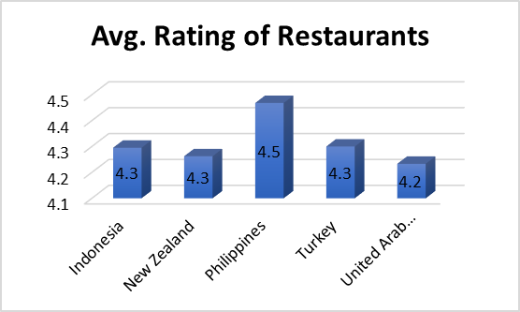
Analysis of objectives Identifying the countries where restaurants can be opened with less competition.
Focused Countries: The best countries which have good market potential for new restaurants are Indonesia, New Zealand, Turkey, Philippines, UAE.
Cities & Region: Considering the above countries here are some cities like Jakarta, Tangerang, Auckland, Willington City, Pasay City, Taguig City, Ankara. Uastanbul, Abu Dhabi, Dubai.

Slide 7
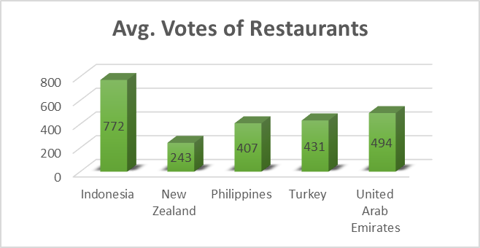
Improve the performance in high-rating area.
Recommendation:
Identify and address the regions where customers have rated the present restaurant with more than 4.0 rating.
Insights
The countries having average rating more than 4.0 are recommended to be focused as good regions to invest.
The countries selected have more than 4.0 rating which explains the good customer feedback and peoples willingness to explore the dining experience in the selected region which will help the company to gain more profits.

Slide 8
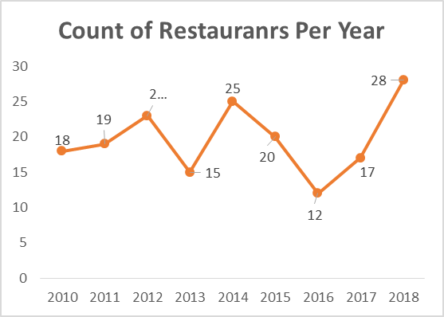
Annual Restaurant Opening Overview.
Narrative.
The Management want to know the yearly pattern of restaurant opening over time provided in data.
Insights.
Each year the number of restaurant opened have increase significantly.
Here is the visualization of the trend followed by previous year data in the countries on which we have targeted.

Slide 9
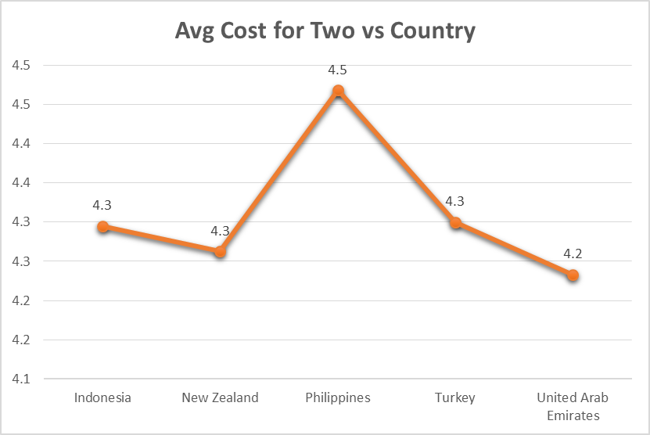
Financial expenditure in countries selected
Analysis.
Countries like UAE and Philippines show maximum expenditure on dining.
Turkey showing lowest expenditure in the list shows that people prefer to save money but it also have good tourist attraction where we can focus and generate good profits.
Conclusion.
Though the expenditure low or high the counties selected have good customer base may be locality or tourist which can generate good profits for the company.

Slide 10
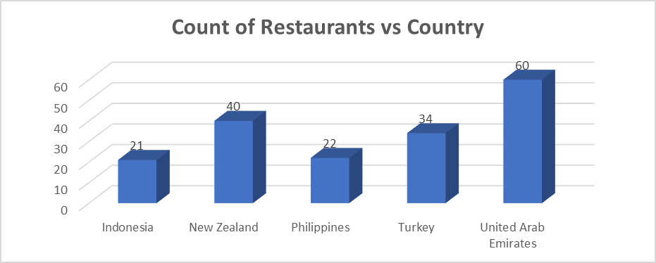
Current Quality in the Recommended Countries and Regions to be targeted.
Overview.
In the countries selected the average rating exceed 4.0 which represent good customer satisfaction and customers will to explore more dining options.
Recommendation.
Indonesia, New Zealand and Philippines have historical background huge natural sites and big costal line leading to attraction for people around the world.
Turkey and UEA are middle east countries and have desert area and many tourist destinations along with it they itself have huge market for dining.

Slide 11
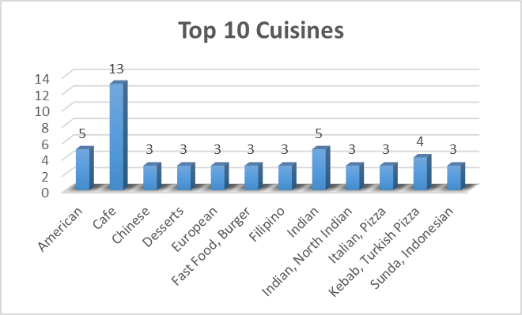
Choice of Cuisines in selected Regions
Overview
Research show American, Asian, Chinese, Indian, North Indian, Italian, Thai, Japanese and Turkish cuisines as best preferred and most rated cuisines in previous restaurants.
Insights
This cuisines have frequently got good rating and huge votes by customer hence zomato can focus on this cuisines to attract and increase the customers with this dining expenditure.

Slide 12
Type of booking to be provided
Analysis
74.34 % Restaurants don’t have online delivery option and 25.66% have online delivery.
87.88% Restaurants don’t have Table booking and 12% have Table Booking.
Recommendation.
It is analyzed that the restaurants that provide online and table booking have received good ratings and good number of votes.
We should focus on providing online and table booking and make dining experience more versatile which will increase the profits of company.

Slide 13
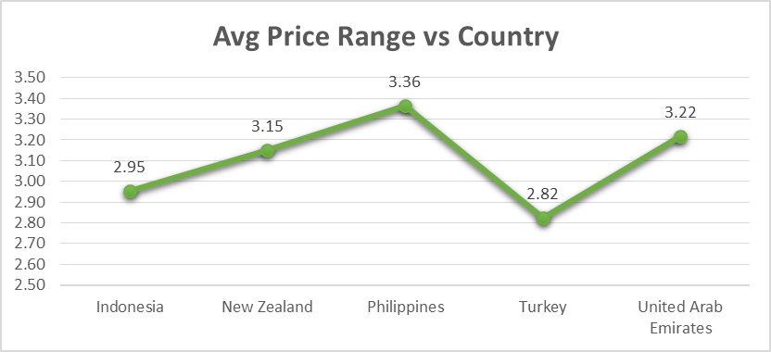
Price Range and its effects.
Analysis.
Price Range vary from 1 to 4 noting the price range of restaurants. Higher the price range higher will be the restaurant brand.
Insights
The analysis shows the countries we have selected have avg price range from 2.82 to 3.36 which indicate that restaurant have good performance and have made brand in itself.

Slide 14
Zomato Restaurants Analysis Dashboard

Slide 15
Conclusion
Growth Opportunities: Company have good opportunity in expanding the business in suggested countries where company can target new customer base and explore new traditional dining segment.
Competative Advantage: The restaurants to be opened have good environment for exploring the market as they can focus on the table dining and online services.
Rating Impact: The ratings analysis provided may help the management to finalize the area or locality or cuisines to be selected for restaurant to be opened.

Slide 16
Thank You

